Slide 1
Moving Dev and Test Government Systems to the Cloud
YWCC 307 - 120
Sky Tech
Karolina Kowal, Filipe Atanes, David Felix

Slide 2
Contents
Introduction
Cloud Services
IaaS
PaaS
SaaS
Benefits of Cloud Services
Implementation of Cloud in Government Services
Conclusion

Slide 3
Introduction
Purpose of Presentation
Cloud Services Overview
Overview of IaaS, PaaS, SaaS
Examples of Successful Implementations
Advantages of cloud services for organizations
Goal of Presentation

Slide 4
Cloud Services
Infrastructure as a Service
Platform as a Service
Software as a Service
IaaS, PaaS, SaaS

Slide 5
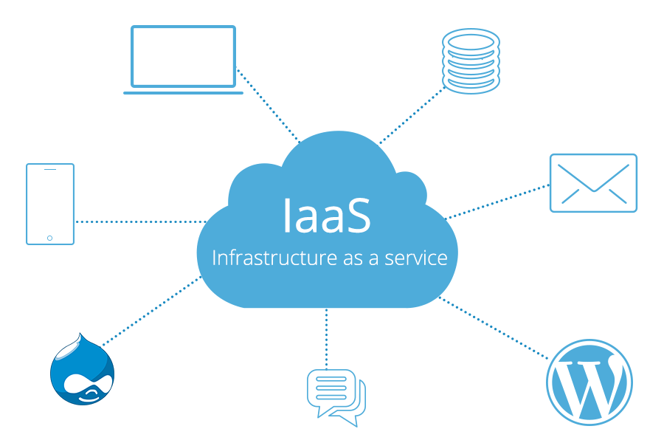
IaaS
Cloud computing model for virtualized computing resources over the internet
Instead of purchasing and maintaining, rent resources from a provider
Benefits: scalability, flexibility, and cost-effectiveness
Quickly provision and deprovision computing resources as needed
Built-in security measures, such as firewalls and data encryption, can help comply with security regulations

Slide 6
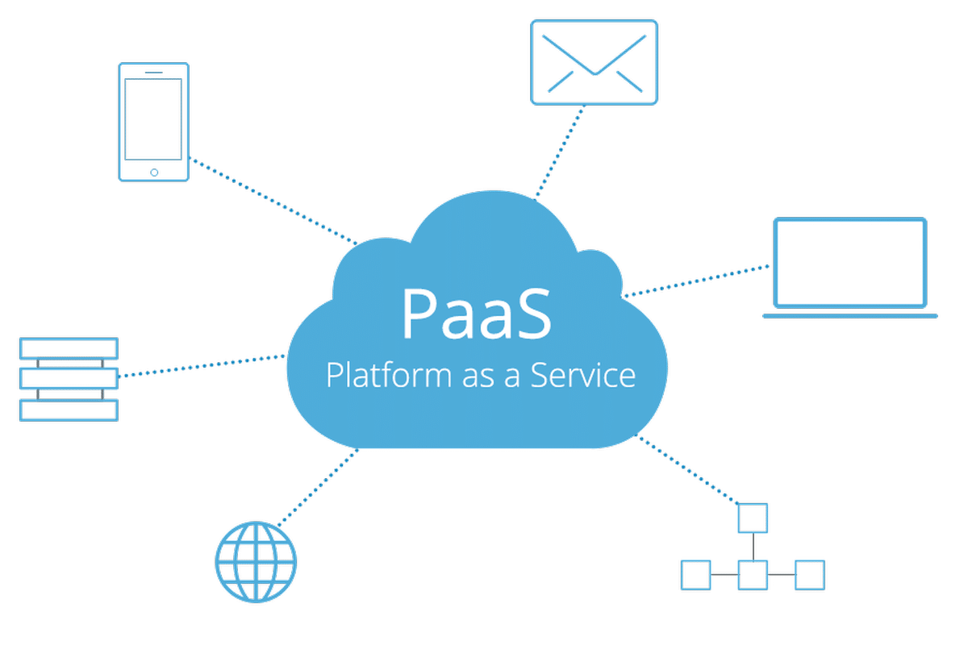
PaaS
Cloud computing model for providing a platform for developers to build and deploy applications
Allows to focus on developing and deploying applications
Can be used for many use cases
Enables quick and secure application development and deployment in a cost-effective way
Can reduce time and resources required for application development and ensure latest security measures
Improved operational efficiency, reduced costs, and better application performance can result from utilizing PaaS.

Slide 7

SaaS
Cloud computing model for providing access to software applications
Enables using software applications on a subscription basis
Used for a wide range of use cases
Ensures the latest up-to-date security measures
Can lead to improved operational efficiency, better collaboration, and reduced IT costs for the government.

Slide 8
Benefits of Cloud Services
Cloud services offer benefits over traditional IT infrastructure for government cloud implementation
Scalability of storage, processing power, and other computing resources
Eliminates need for hardware, software, and maintenance costs
Provides high level of redundancy and disaster recovery capabilities
Offers high level of security and compliance with government regulations
Enables seamless collaboration and communication across different departments and agencies

Slide 9
Implementation of Cloud in Government Services
Cloud services provide benefits over traditional IT infrastructure for government cloud implementation
Infrastructure as a Service (IaaS) allows renting computing infrastructure from cloud service providers for flexible scaling
Platform as a Service (PaaS) enables developers to build, test, and deploy applications without worrying about underlying infrastructure, accelerating application development and deployment
Software as a Service (SaaS) provides access to software applications hosted on the cloud, reducing the cost and complexity of IT infrastructure
Cloud storage services offer scalable, secure, and cost-effective storage solutions for government data management
Cloud security services provide advanced security and compliance capabilities for government cloud implementations
Leveraging these cloud services can streamline IT operations, improve security posture, and deliver better services to constituents.

Slide 10

Microsoft Azure
Rent computing infrastructure from the cloud provider
Virtual machines, storage, and networking capabilities
Deploy and manage IT infrastructure
Customization of infrastructure
Security and compliance features
IaaS

Slide 11

Google Workspace
Helps develop, test, and deploy applications
Google Docs, Sheets, and Slides
Google App Engine
Advanced threat detection, data loss prevention, and access controls
PaaS

Slide 12
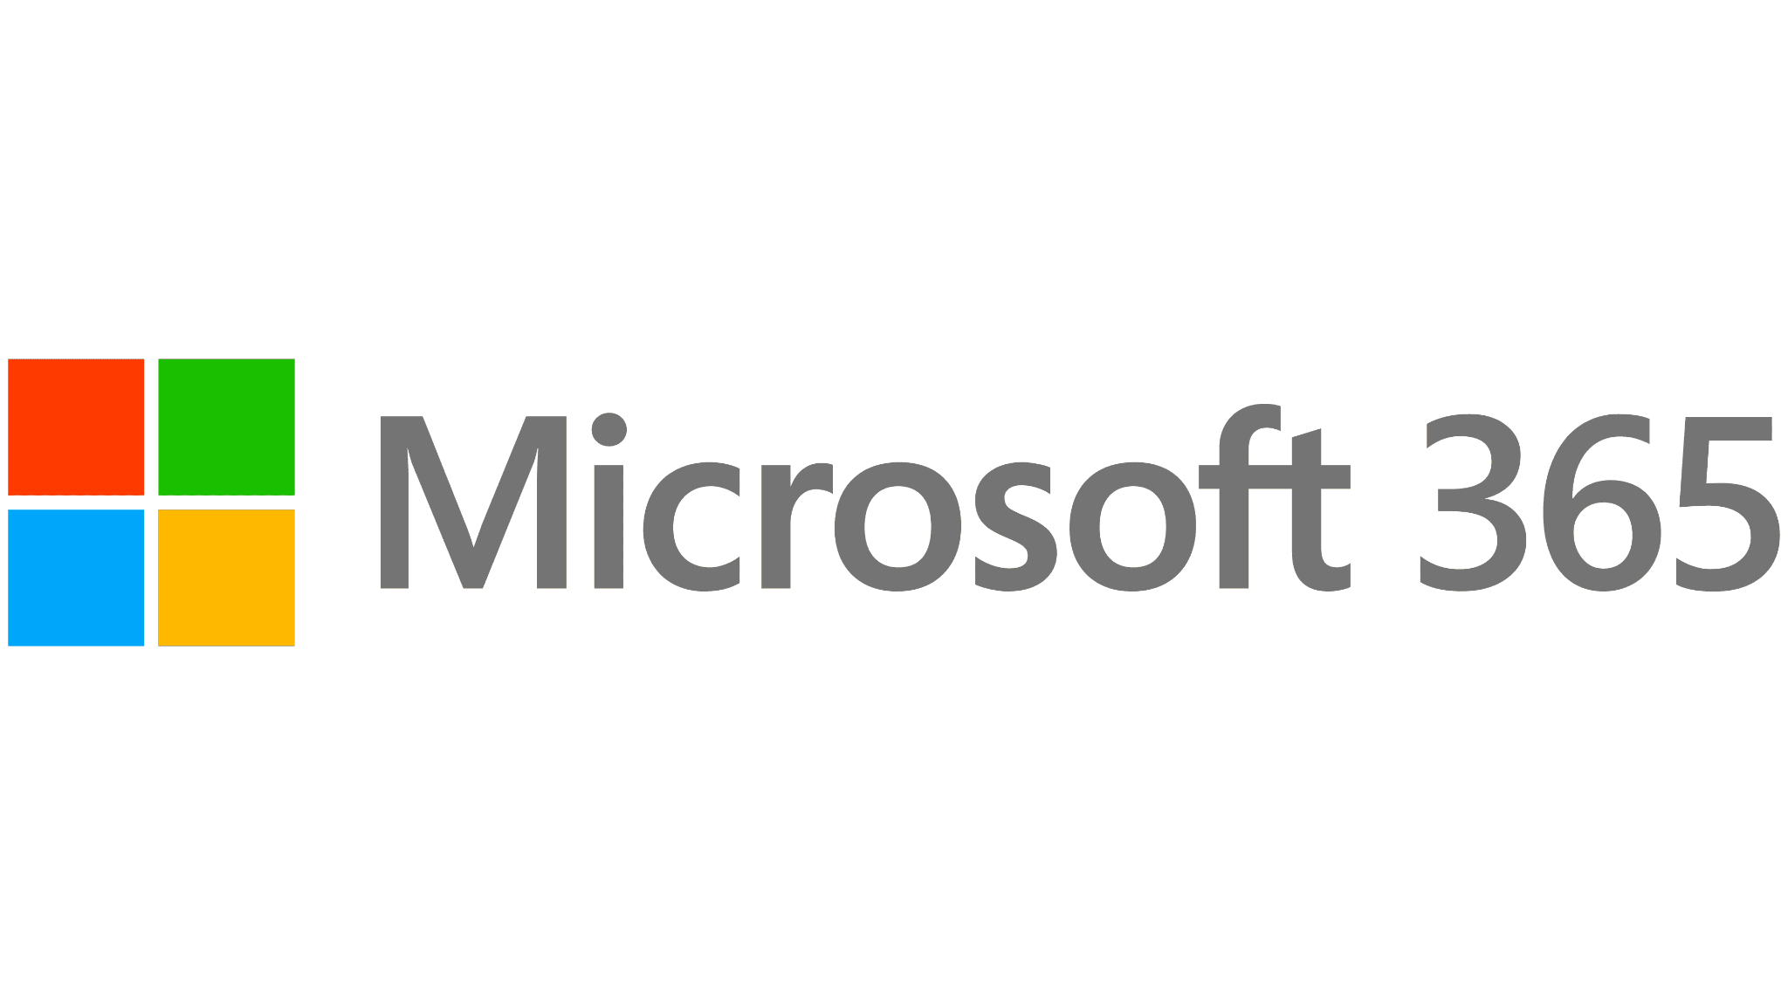
Microsoft Office 365
Word, Excel, PowerPoint, and Outlook
Communication with Microsoft Teams
Accessible from any location
Data encryption, advanced threat protection, and access controls
SaaS

Slide 13
Conclusion

Slide 14
References
Amazon Web Services. (n.d.). AWS for Government. Retrieved from https://aws.amazon.com/federal/?wwps-cards.sort-by=item.additionalFields.sortDate&wwps-cards.sort-order=desc
Built In. (n.d.). 7 Cloud Computing Examples That Will Help You Understand the Technology Better. Retrieved from https://builtin.com/cloud-computing/cloud-computing-examples
cloud.gov. (n.d.). What is cloud.gov? Retrieved from https://cloud.gov/
DesignRush. (n.d.). Types of Cloud Services. Retrieved from https://www.designrush.com/agency/cybersecurity/trends/types-of-cloud-services
Fisher, D. (2021, January 6). The top cloud providers for government. ZDNet. Retrieved from https://www.zdnet.com/article/the-top-cloud-providers-for-government/
Government Accountability Office. (2019). Information Technology: Agencies Need to Develop and Implement Guidelines for Procurement and Management of Cloud Services. Retrieved from https://www.gao.gov/assets/gao-19-58.pdf

Slide 15
References
GovLoop. (n.d.). Security Procurement Workforce: Cloud Computing. Retrieved from https://go.govloop.com/rs/231-DWB-776/images/Security-Procurement-Workforce.pdf
Kepes, B. (2012, August 31). Homeland Security Plans 12 Cloud Services. InformationWeek. Retrieved from https://www.informationweek.com/cloud/homeland-security-plans-12-cloud-services/d/d-id/1105939
Microsoft. (n.d.). What are Private, Public, and Hybrid Clouds? Retrieved from https://azure.microsoft.com/en-us/resources/cloud-computing-dictionary/what-are-private-public-hybrid-clouds/#faq
Office of Management and Budget. (2011). Federal Cloud Computing Strategy. Retrieved from https://obamawhitehouse.archives.gov/sites/default/files/omb/assets/egov_docs/federal-cloud-computing-strategy.pdf
Office, U. S. G. A. (2023, March 9). Is the cloud saving the government money? U.S. GAO. Retrieved April 27, 2023, from https://www.gao.gov/blog/2019/06/27/is-the-cloud-saving-the-government-money#:~:text=To%20deliver%20better%20IT%20services%20for%20less%20money%2C,at%20a%20lower%20cost%20than%20individual%20agencies%20can.
Pandadoc. (n.d.). How to Write a Technical Proposal [Blog post]. Retrieved from https://www.pandadoc.com/blog/how-to-write-a-technical-proposal/
The White House. (2019). Cloud Smart Strategy. Retrieved from https://www.whitehouse.gov/wp-content/uploads/2019/06/Cloud-Strategy.pdf
U.S. Department of the Interior. (n.d.). Cloud Strategy. Retrieved from https://www.doi.gov/cloud/strategy
U.S. Department of the Treasury. (2018). The Treasury Cloud Report. Retrieved from https://home.treasury.gov/system/files/136/Treasury-Cloud-Report.pdf
Zhang, Q., Cheng, L., & Boutaba, R. (2010). Cloud Computing: State-of-the-Art and Research Challenges. Journal of Internet Services and Applications, 1(1), 7-18. doi:10.1007/s13174-010-0007-6

Slide 16
References
Pandadoc. (n.d.). How to Write a Technical Proposal [Blog post]. Retrieved from https://www.pandadoc.com/blog/how-to-write-a-technical-proposal/
The White House. (2019). Cloud Smart Strategy. Retrieved from https://www.whitehouse.gov/wp-content/uploads/2019/06/Cloud-Strategy.pdf
U.S. Department of the Interior. (n.d.). Cloud Strategy. Retrieved from https://www.doi.gov/cloud/strategy
U.S. Department of the Treasury. (2018). The Treasury Cloud Report. Retrieved from https://home.treasury.gov/system/files/136/Treasury-Cloud-Report.pdf
Zhang, Q., Cheng, L., & Boutaba, R. (2010). Cloud Computing: State-of-the-Art and Research Challenges. Journal of Internet Services and Applications, 1(1), 7-18. doi:10.1007/s13174-010-0007-6

